Slide 1
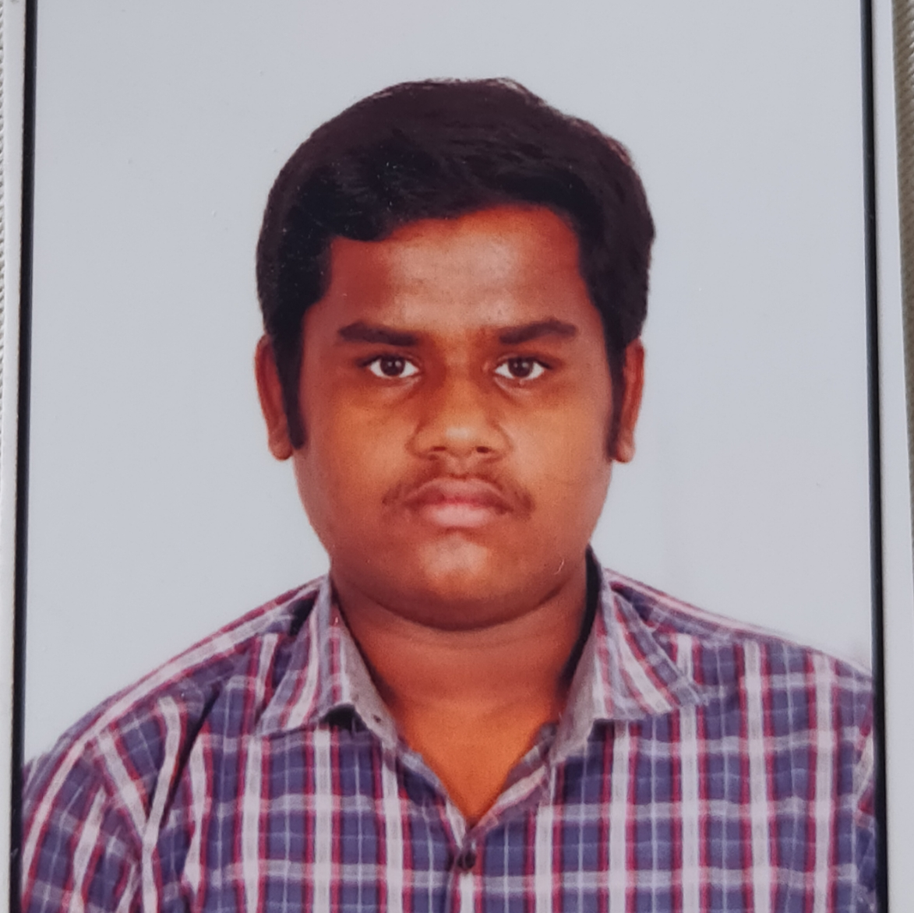


Asir Anugraham
Masters of Computer Application
YEAR:2019-2021
Analyst/Software Engineer
Skills
Mumbai
JAVA | Basics of java, Core Java,, Oops concepts
UI Framework-React | Fundamentals components ,Java Script, Working with states & props in React , Event Handling in React , Routing ,Life Cycle Method
React | Components, Services, Modules, Routing, Forms & Validation,
Database | MongoDB
UI Tech | Done Certification in HTML,CSS, JavaScript in Coursera
Tools | Spring Tool ,Visual Studio 2019, Visual Studio code, Swagger, Postman, IntelliJ, Mongo Compass
Add On skills | Communications, Time Management
asir.anugraham@capgemini.com
+91 9962346536
A4
Proficient in JAVA concepts.
Hands on experience in creating Web Application with Spring Boot and React.
Practical Understanding of Mongo Database
Hands on experience in developing web pages using HTML5, CSS3, OOPS, JSON, XML. Good understanding of Document Object Model (DOM) and DOM Functions.
Practical understanding of rendering SPRINGMVC, REST API.
Proficient React developer with working knowledge on React.
And having handson knowledge in Git and GitHub
ONLINE SHOPPING APPLICATION
Working on case study for Online Shopping Application along with authentication, Swagger and React Sonar lint and Code Coverage.
Java Full Stack Developer in Degreed Platform
Completed this course with optimal Knowledge of Spring Boot , Microservices , Spring mvc and Security

